Slide 1
The French and Indian War
Part 2
Competition Leads to Violence

Slide 2
Starting Ideas
What is something you like to do or have? What would you do if you could no longer have it or do it anymore?

Slide 3
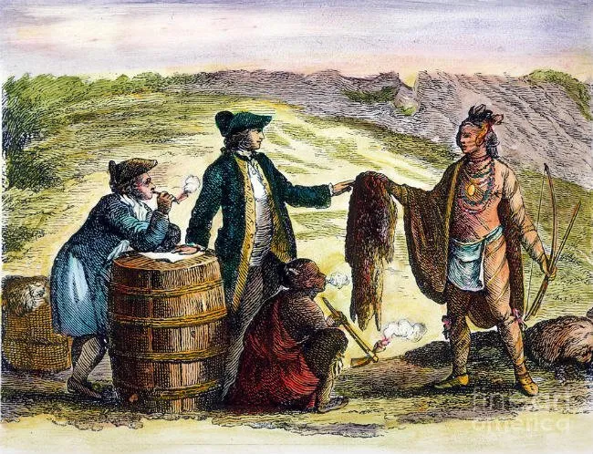
Both the French and British were involved in the fur trade with the Native Americans.

Slide 4
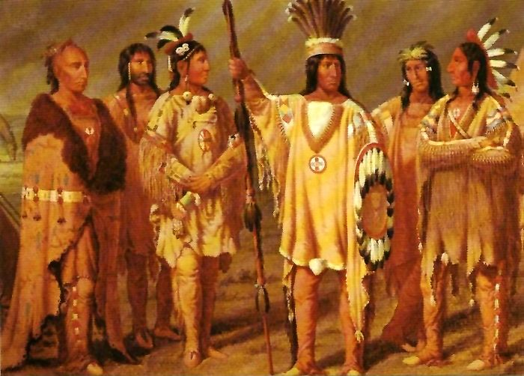
The French traded with Huron and several Algonquian tribes in the St. Lawrence River Valley and Great Lakes region.

Slide 5
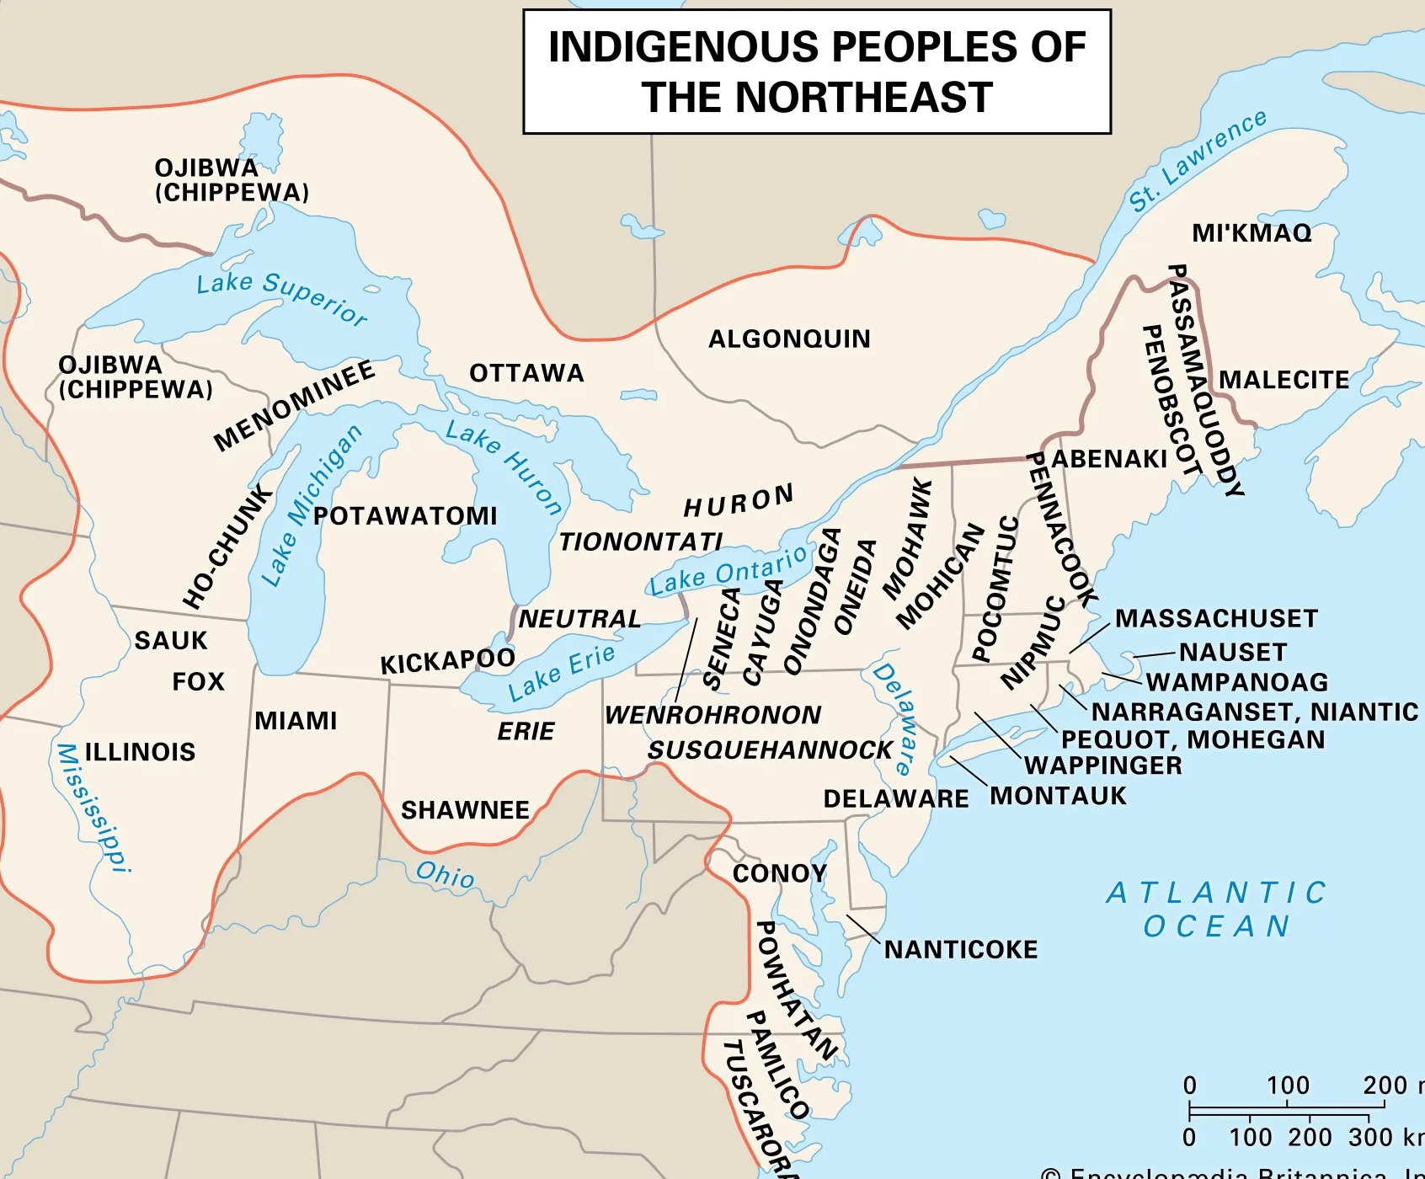
The British traded with the Native Americans throughout the area of the British colonies, specifically the middle and New England colonies.

Slide 6
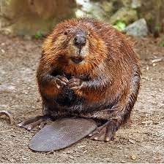
Unfortunately, many fur-bearing animals, specifically beavers, were being hunted to near extinction in some areas.

Slide 7
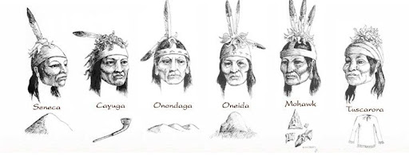
This led the Iroquois League of Five Nations to fight against neighboring tribes for control of more land to expand their hunting grounds.

Slide 8
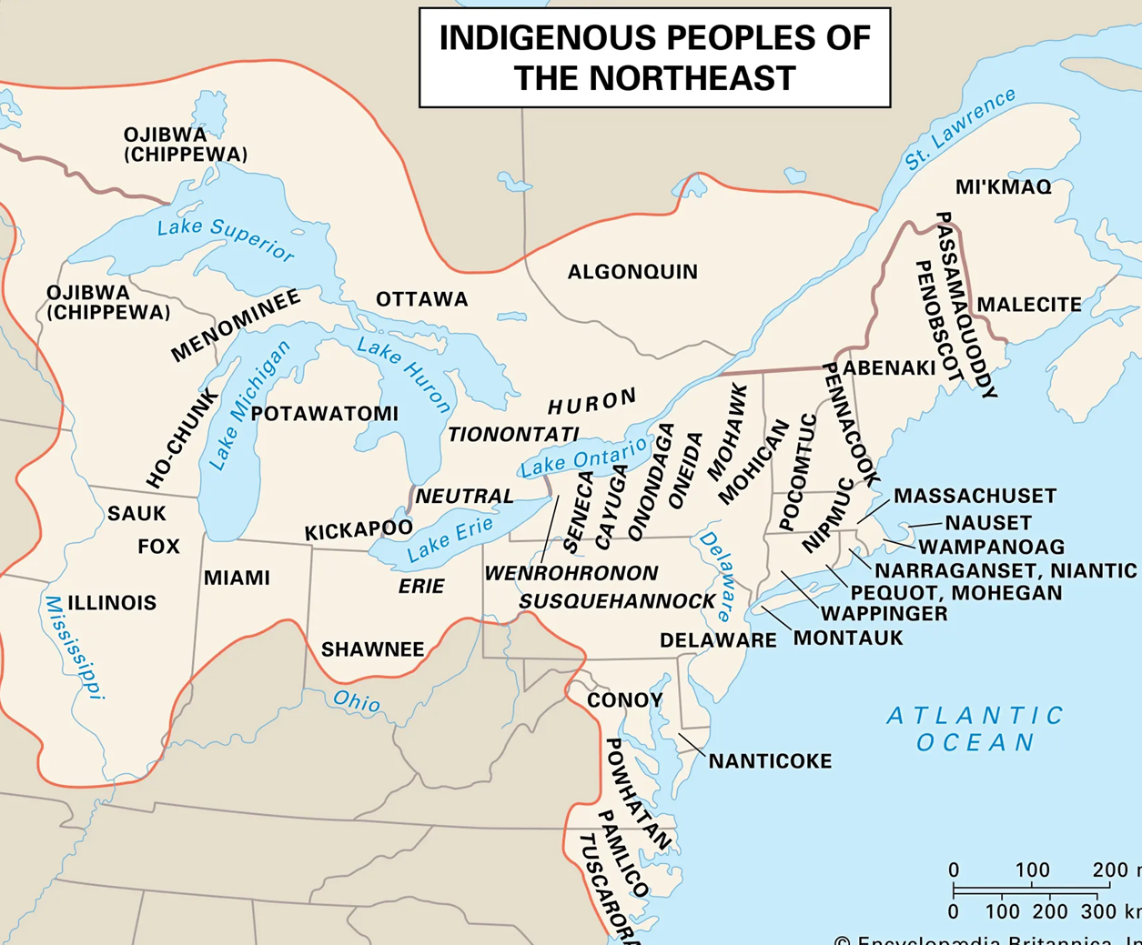

Slide 9
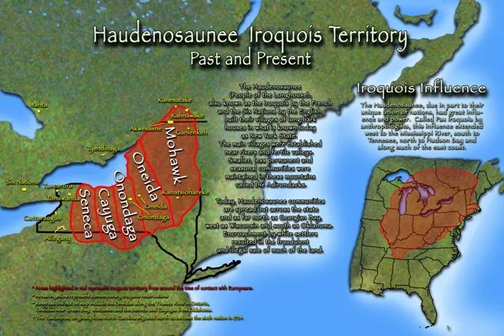
By the mid-1600s, the Iroquois had defeated the Huron to gain control of an area that extended from Maine to the Ohio Valley north to Lake Michigan.

Slide 10
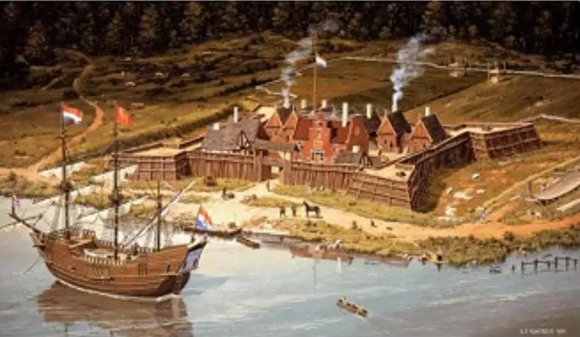
By 1670, Iroquois fur traders were bringing a million pounds of beaver skins to the trading post at Albany each year to trade with the British.

Slide 11
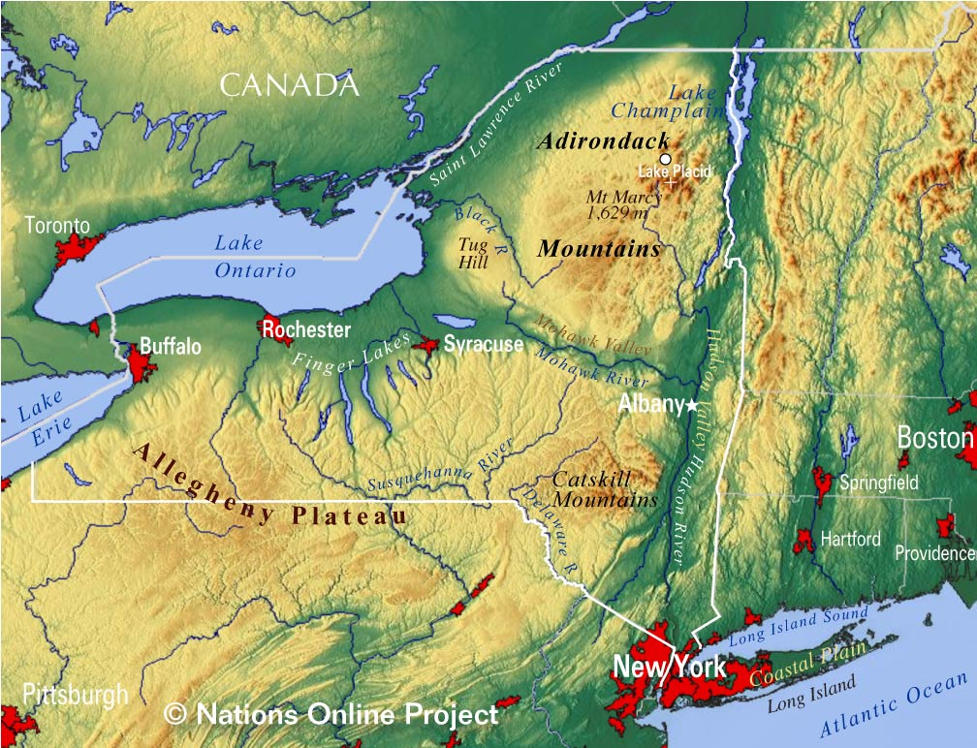

Slide 12
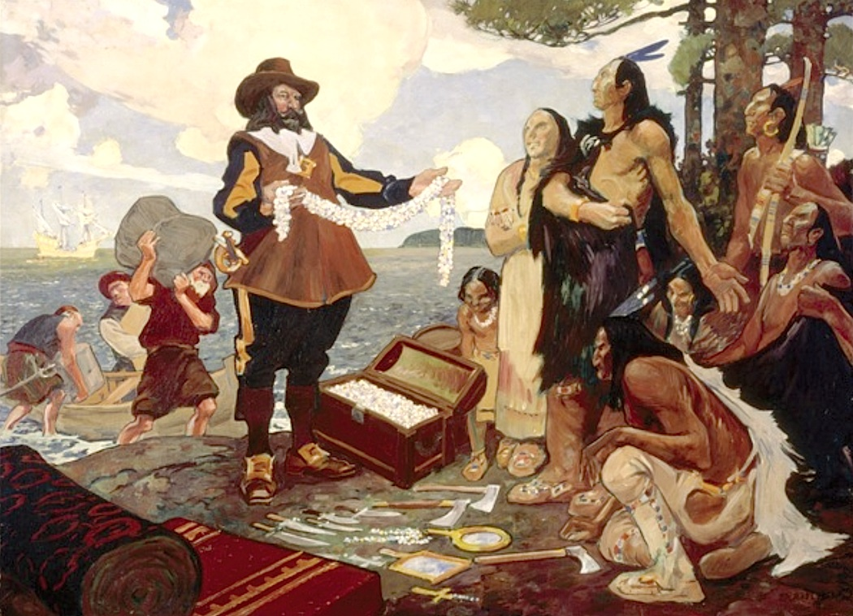
This threatened the French fur trade which would eventually lead to violence.

Slide 13
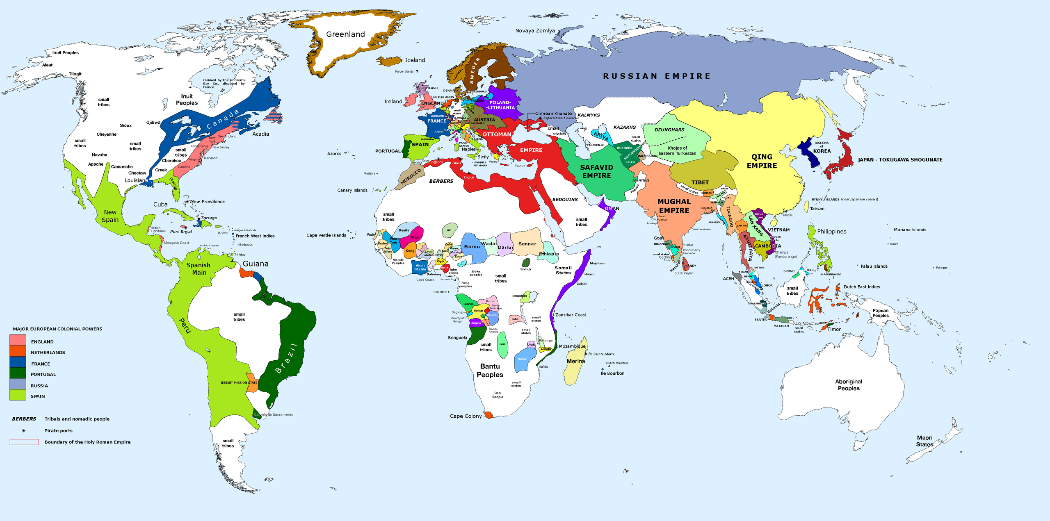
Remember, events don’t happen in isolation and Great Britain and France had a rivalry in different places throughout the world.

Slide 14
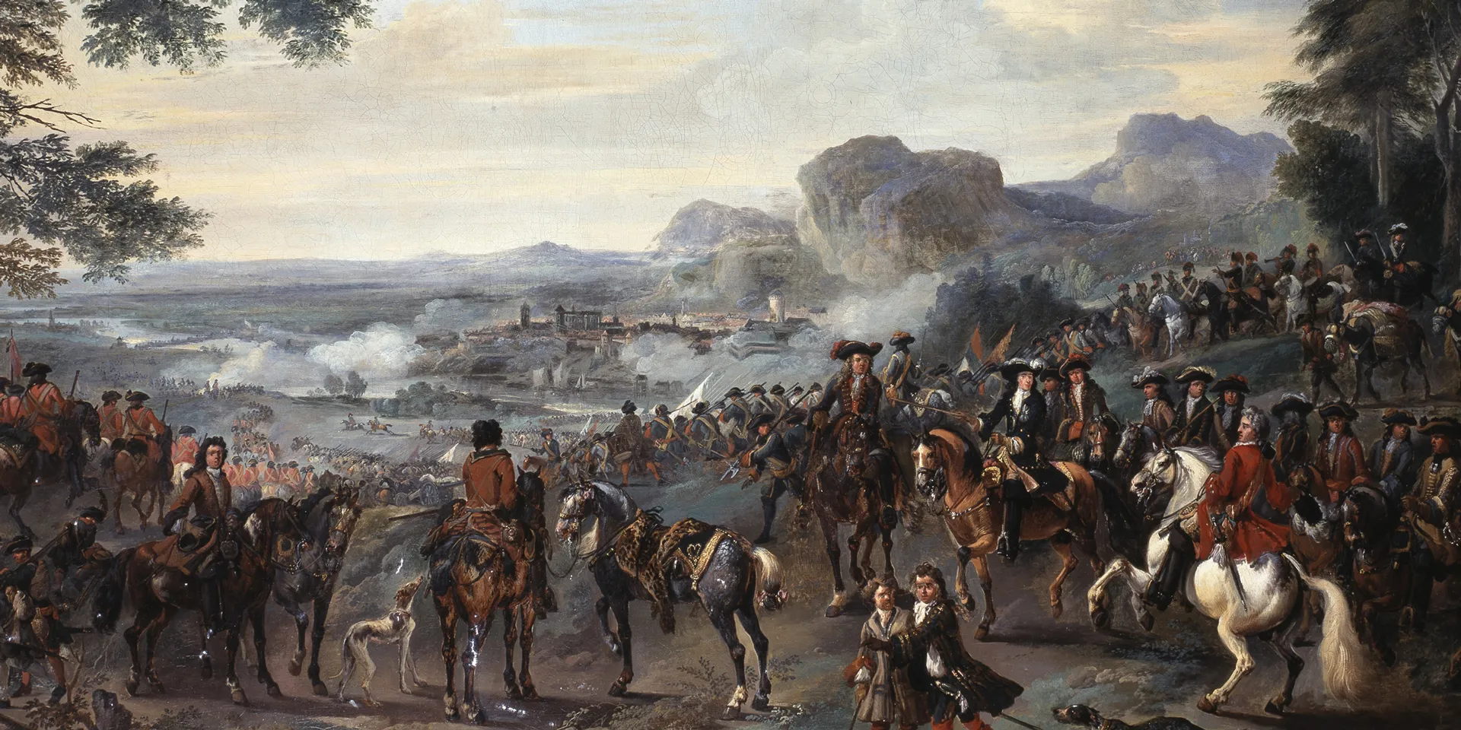
From1688-1697, Great Britain and France fought the Nine Year’s War in Europe, India, and West Africa.

Slide 15
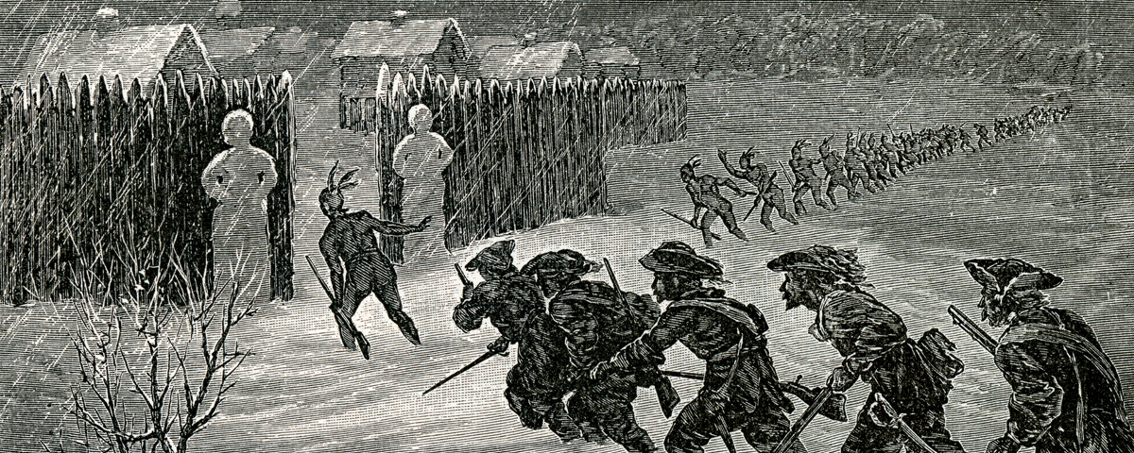
In 1689, fighting broke out in North America when the French and their Native American allies, the Huron and Algonquian, initiated a series of attacks of British settlements along the frontier in New England.

Slide 16
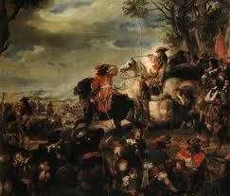
The British colonists responded by forming a coalition of New England colonies led by Massachusetts and raised an army to defend against the French and their Native American allies.

Slide 17
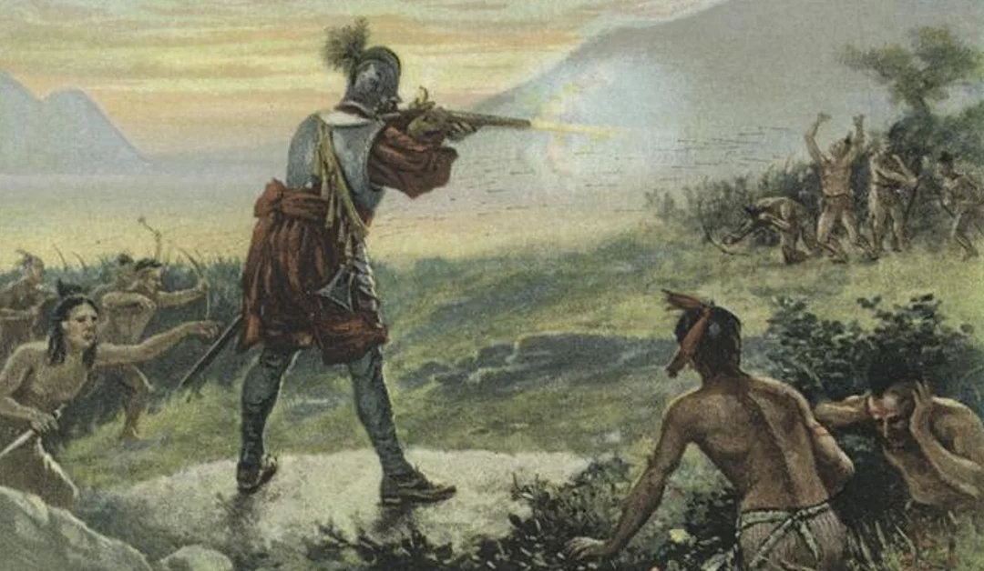
The Iroquois sided with the British and helped try to defend the frontier against French and their Native American allies.

Slide 18
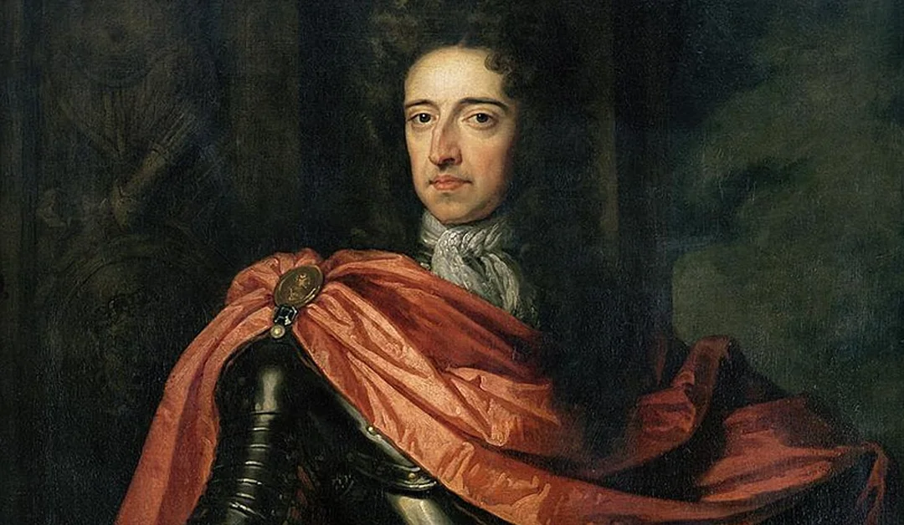
The fighting that would continue for the next eight years was known as King William’s War, named after the King William III of England. (King Louis XIV was king of France at the time.)

Slide 19
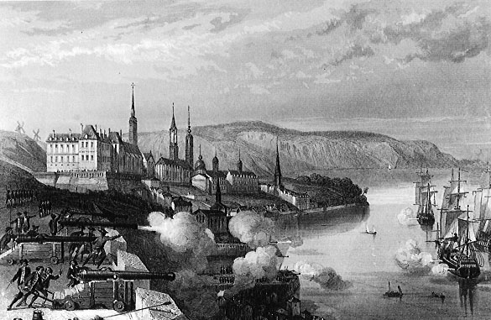
The first major battle was when the British colonists tried to capture Quebec (New France) in 1690. The British were defeated in their attempt.

Slide 20
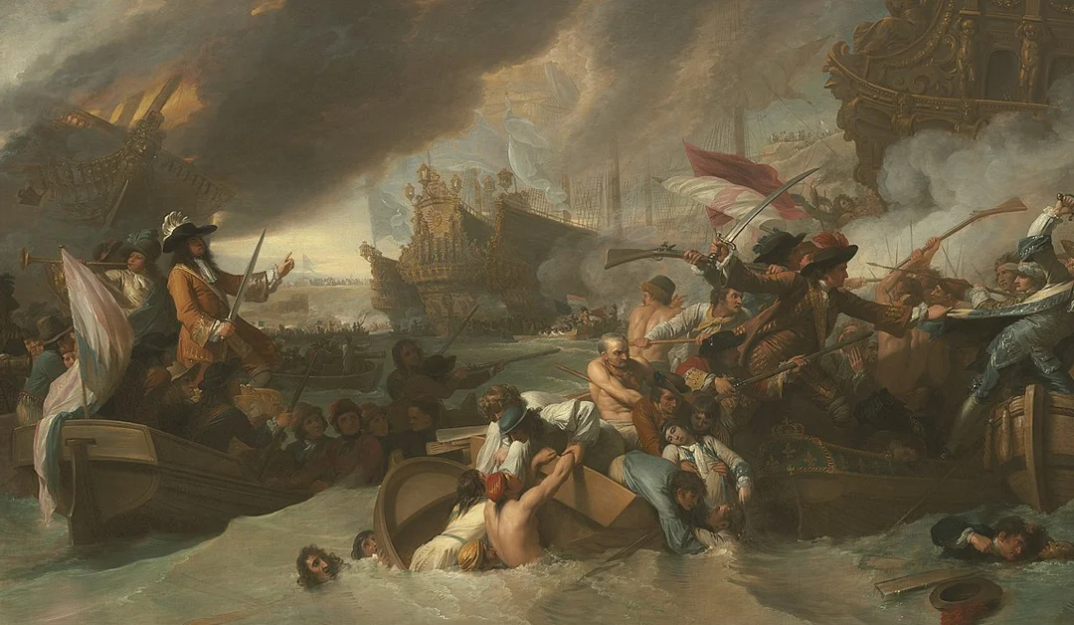
Britain had naval superiority throughout the war. How do you think that helped them?
This allowed Britain to control the seas and block the French from supplying their colony of New France.

Slide 21
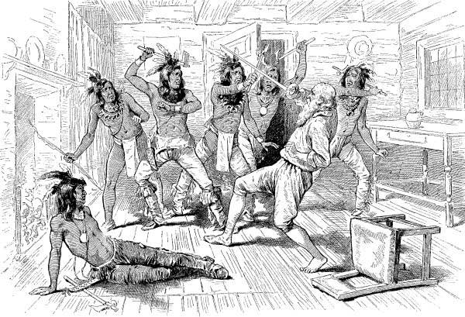
On land, there were many raids and small battles throughout the war. The French and Native American allies used guerilla tactics of quick attacks on unsuspecting victims.

Slide 22
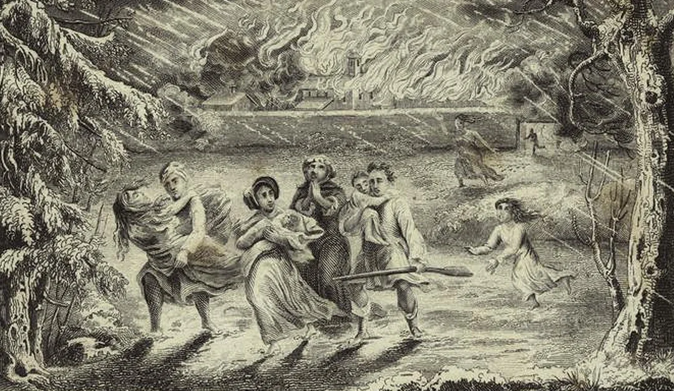
Read the section Frontier Brutality on page 160 of your textbook. Describe how you would feel if you were a settler living on the frontier at that time.

Slide 23
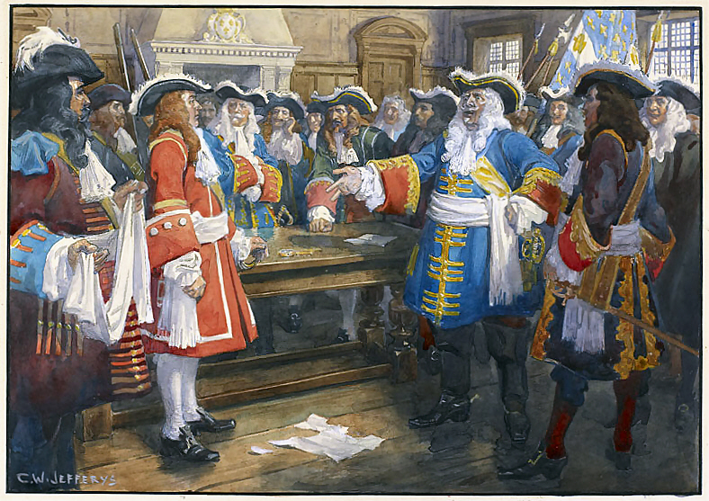
The war finally ended with the signing of the Treaty of Ryswick in 1697. It stated that any captured land during the war should be given back to the original people who occupied it before the war.

Slide 24
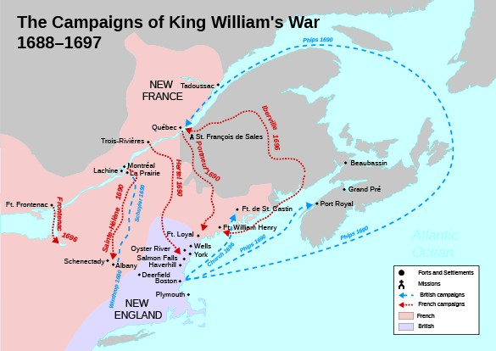
King William’s War established a pattern of French and British competition in North America. It also affected Native Americans in the area who got caught in the middle and suffered greatly as a result.

